Slide 1
Supervised ML
- LDA

Slide 2

Framework to solve a Business problem
Identify the clear objective of the business problem
Convert the business problem into a statistical/Algorithmic problem
Find ways to merge different datasets and bring them to a unified platform; identify merging keys
The final dataset should not be having duplicate records; For ex, If the Model is to be built at customer level, The data needs to be unique at customer level.
Data preparation(Missing treatment, Outlier treatment, dummy variable creation, 70:30 split
(Model development & validation)
Develop the Model on 70% dataset
Validate the model on remaining 30% dataset
2

Slide 3

Business Problems:
A credit card company has launched a campaign to target their Gold credit cardholders and offer them the platinum credit card. The company wants to build a model which can identify customers who have high likelihood to respond.
A bank wants to target their Mortgage customers and offer them an auto loan. The bank wants to build a model which can identify mortgage customers that have high likelihood to respond to Auto loan offer.
3

Slide 4

Business Problems:
An energy utility company had installed battery powered meters at every household to regulate gas/electricity. The company wants to predict battery failure to ensure necessary proactive action can be taken to prevent failures.
An insurance company is incurring $$ 5 MM losses due to fraudulent claims. They want to identify potential fraudulent cases to reduce their losses by 50%.
4

Slide 5
Business Problems:
A US bank is incurring huge customer attrition in their mortgage portfolio due to high competition. They want to identify customers who have high likelihood to refinance and offer them the next best product out of their 5 mortgage products.
5

Slide 6
Linear Discriminant Analysis
Discriminant Analysis(DA)is a technique for analyzing data when dependent variable is categorical and the predictor variables are continuous.
It is a technique to discriminate between two or more mutually exclusive and exhaustive groups on the basis of some explanatory variables.
6

Slide 7
Linear Discriminant Analysis
LDA is similar to Principal Component Analysis (PCA) and factor analysis as they both look for linear combinations of variables which best explain the data.
But LDA focuses on maximizing the separability among known groups which PCA or Factor Analysis doesn’t.
8

Slide 8
LDA & PCA
Both ranks the new axes in order of importance
  LD1(the first new axis that LDA creates) accounts for the most variation between the categories
  LD2(the 2nd new axis that LDA creates) is 2nd best in separating the categories
  PC1(the first new axis that PCA creates) accounts for the most variation in the data
  PC2(the 2nd new axis that PCA creates) does the 2nd best job.

Slide 9

The Discriminant Function
The discriminant analysis model involves linear combinations of
the following form:
D = b₀ + b₁X₁ + b₂X₂ + b₃X₃ + . . . + b_{k}X_{k}
where
D = discriminant score
b 's = discriminant coefficient or weight
X 's = predictor or independent variable
◆ The coefficients, or weights (b), are estimated so that the groups differ as much as possible on the values of the discriminant function.
◆ Discriminant analysis – creates an equation which will minimize the possibility of misclassifying cases into their respective groups or categories
9

Slide 10
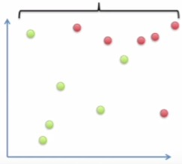


Spatial interpretation:
A simple example:
What’s the best way to reduce the dimensions??
A 2 D Graph
A 1 D Graph
Var y
Var x
10

Slide 11
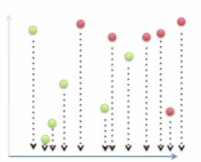
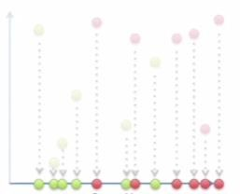
Linear Discriminant Analysis
What will happen if we ignore variable Y and use only variable X to find the maximum separation among categories??
Is this optimal way of finding maximum separation??
Var x
Var x
11

Slide 12
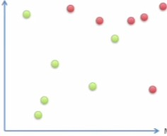
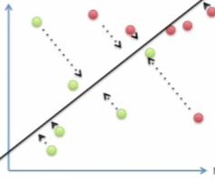
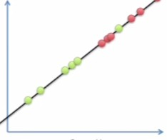
Linear Discriminant Analysis
LDA uses both the axes to create a new axis and projects the data on this new axis to ensure maximum separability among categories.
Var y
Var y
Var y
Var x
Var x
Var x
12

Slide 13
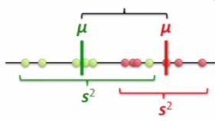

How LDA creates a new axis??
The new axis is created using two criteria, both is considered simultaneously.
Maximize the distance between means
d =
,d is the distance
Ideally Large
Ideally Small
Minimize the variation (or scatter) within each category

Slide 14
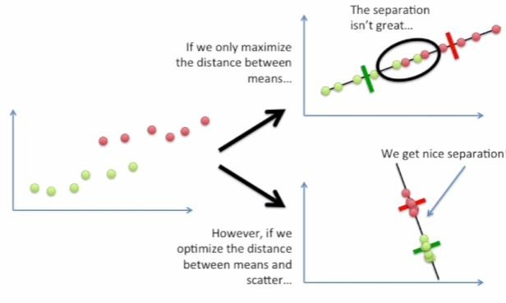
Why distance and scatter both are important??

Slide 15
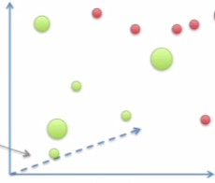
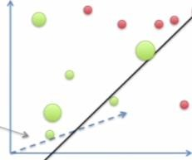
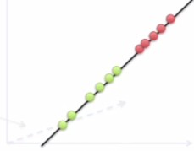
LDA with 3 variables
The process of choosing the Axis will remain same
  Create an Axis that maximizes the distance between the categories while minimizing the scatter
  The data is projected on a new axis in order to maximize the distance between the two group means while minimizing the scatter

Slide 16
LDA with 3 Categories??
Two things change for LDA with more than 2 categories:
- The first difference is how distance is measured among means
    A point is located first which is central to all the data,
    Then, distance is measured between a point central in each category and the central point
    Now, Maximize the distance between central point of each category and
the central data point while minimizing the scatter for each category
- The second difference is, LDA creates two axes to separate the data. The 3
central points in each category defines a plane
    with 3 points, we can draw 2 lines to optimize separation

Slide 17
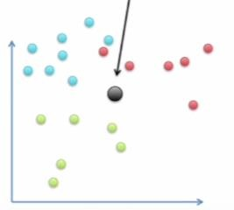
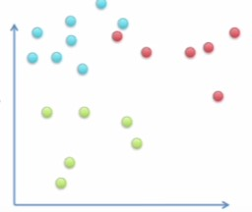
LDA with 3 Categories??
The point central to the data
Var y
Var y
Var x
Var x

Slide 18
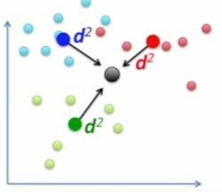

LDA with 3 Categories
Measure the distance between a point central to each category and the main central point
Now Maximize the distance between each category and central point while minimizing the scatter
Var y
Var x

Slide 19
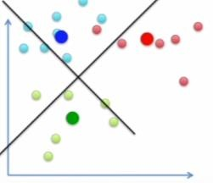
LDA with 3 Categories
The second difference is LDA creates 2 axes to separate the data to ensure maximum separation among categories. The 3 central points for each category defines a plane.
The two lines are used to optimize separation.
Var y
Var x

Slide 20
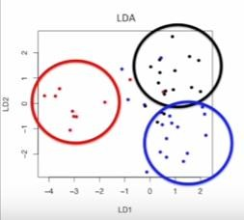
LDA with 3 Categories and 1000 dimesions
What will you do if you have 3 categories and 1000 dimesions in the dataset??
We would need 1,000 dimensions to draw the data. Which is obviously not possible??
Number of discriminant functions created by LDA:
= Min ( # of categories – 1, # of dimensions)
Though the separation is not perfect, but it’s easy to see 3 separate categories

Slide 21
CASE STUDY

Slide 22
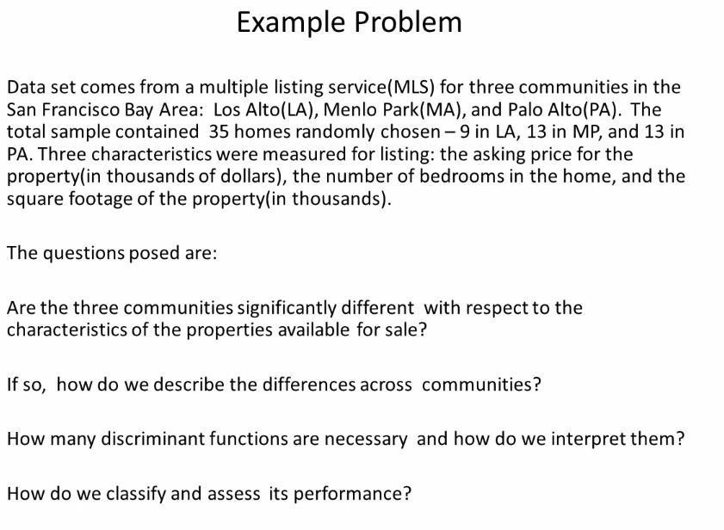

Slide 23
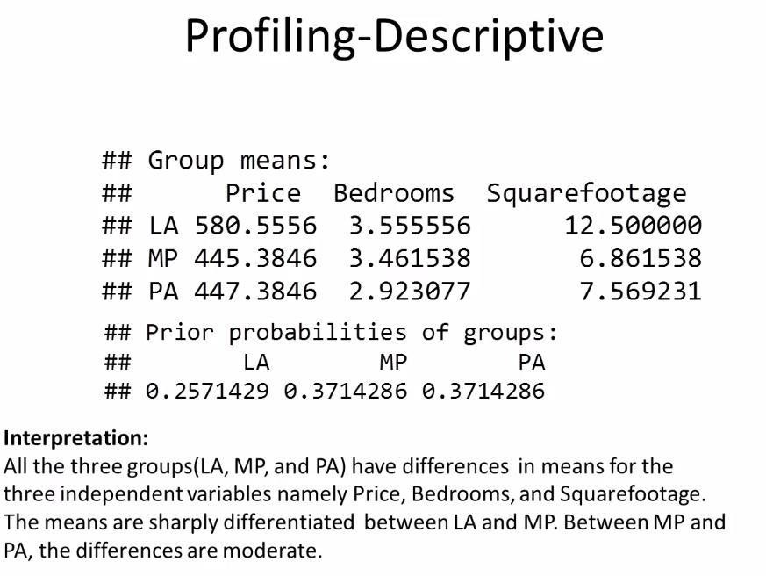

Slide 24
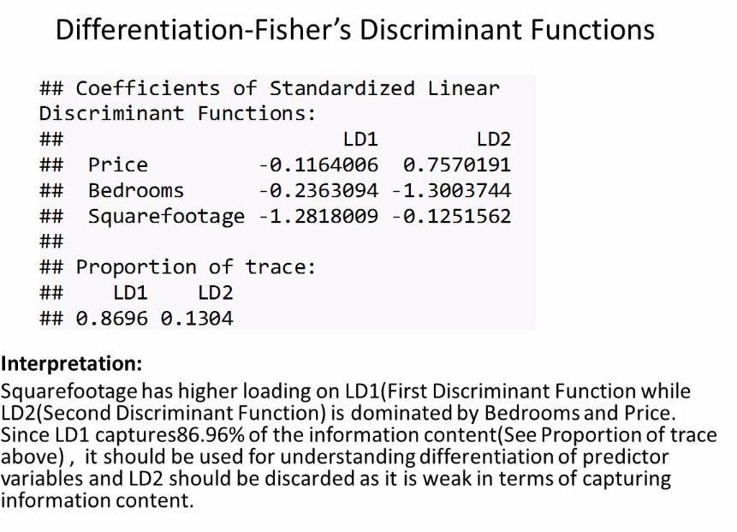

Slide 25
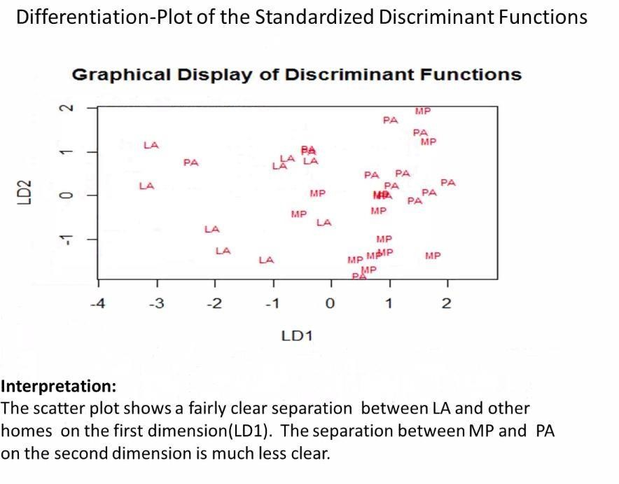

Slide 26
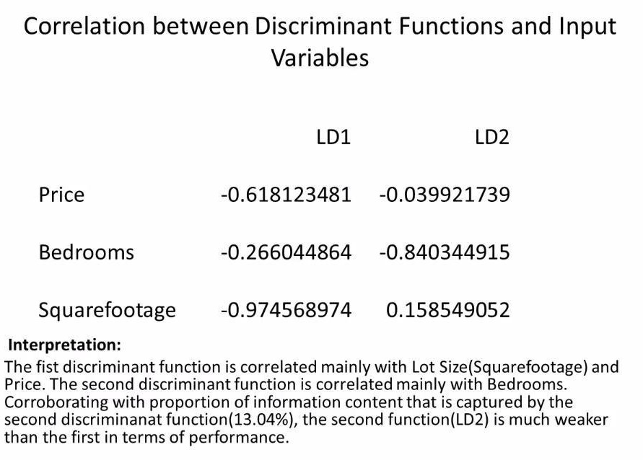

Slide 27
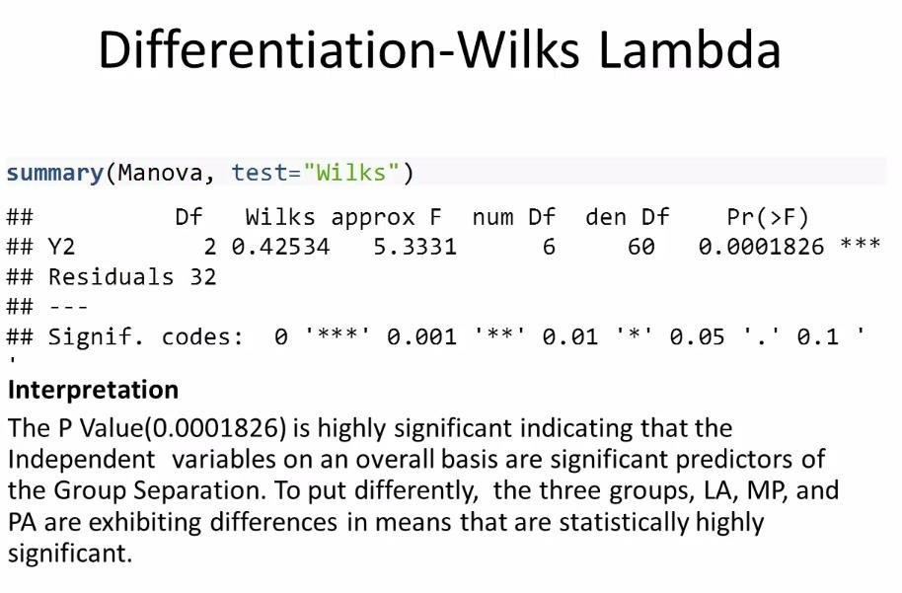

Slide 28
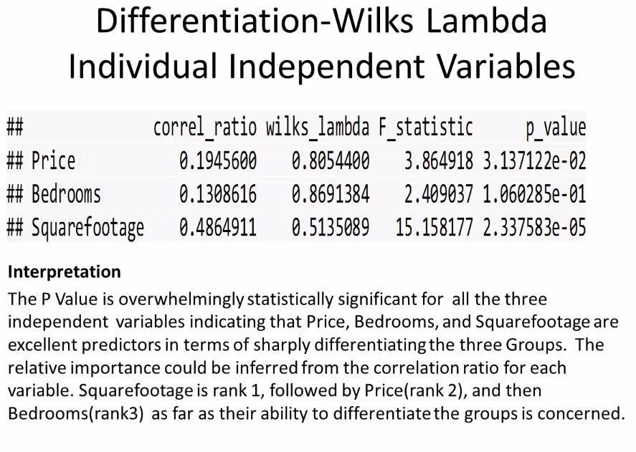

Slide 29
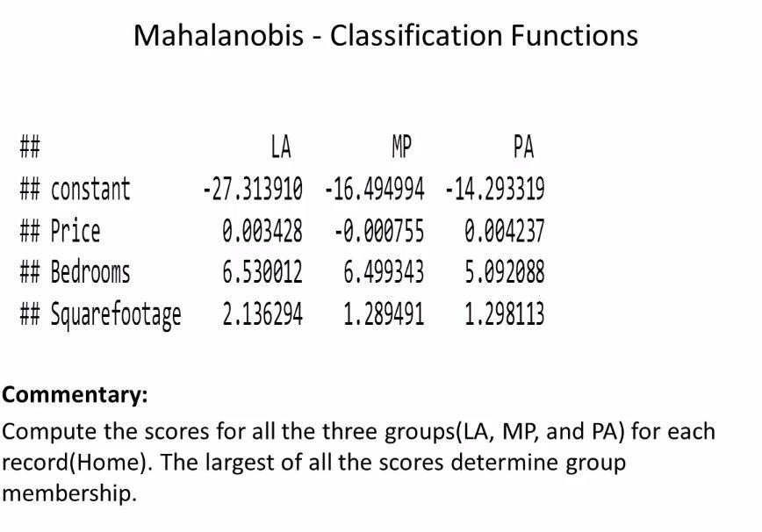

Slide 30
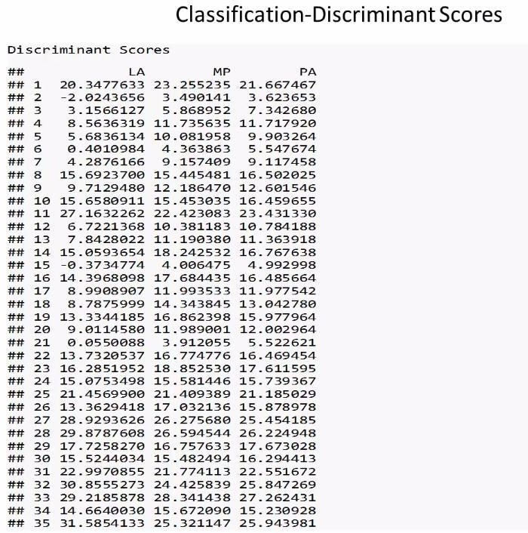

Slide 31
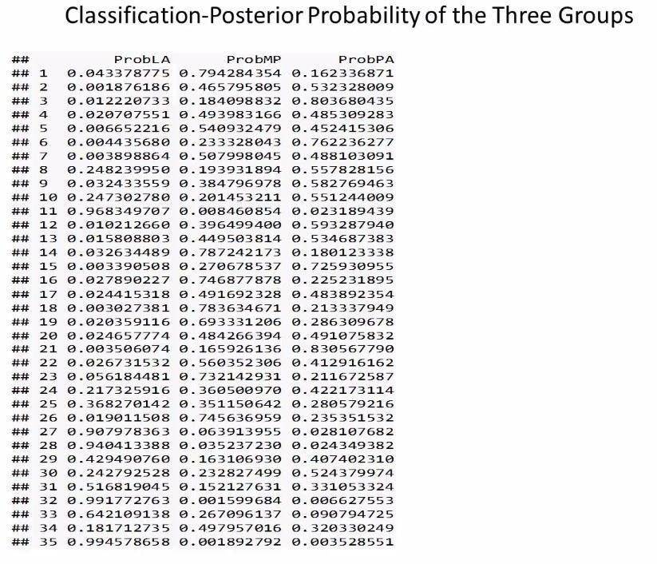

Slide 32
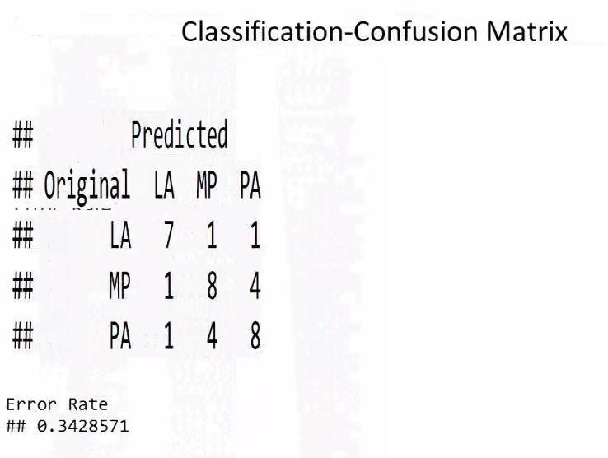

Slide 33
THANK YOU

